Slide 1
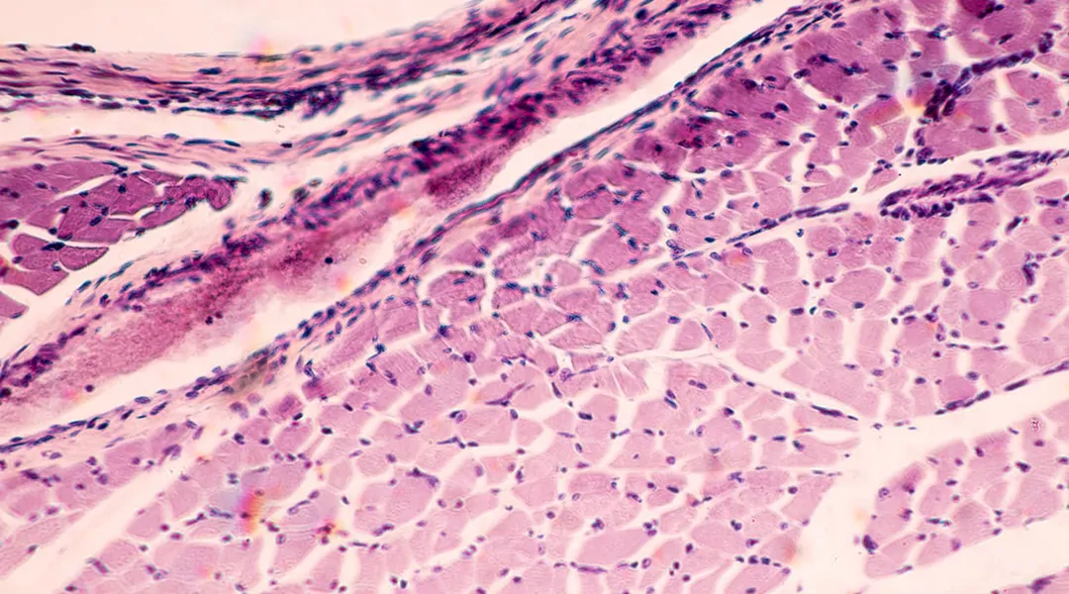
Reverting the clock
from micro to the muscle

Slide 2

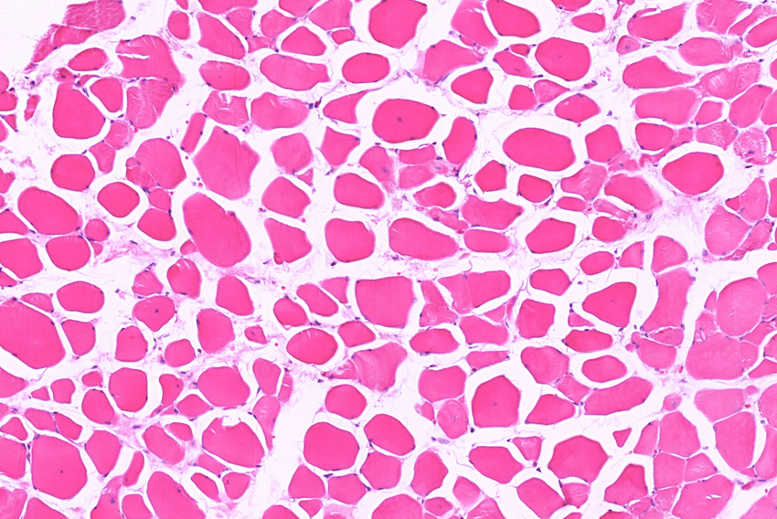
~3 – 15 %
Loss of muscle mass per decade

Slide 3
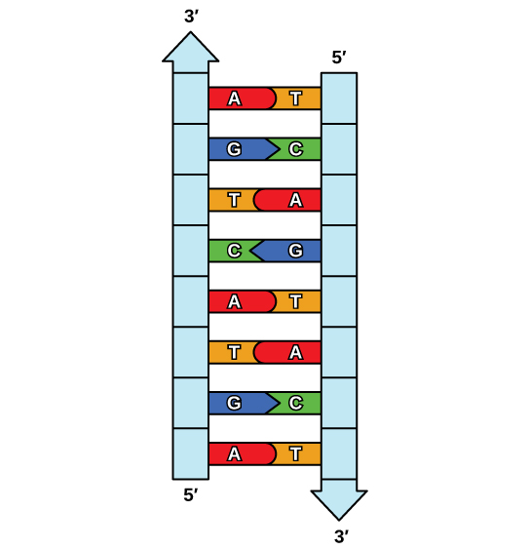
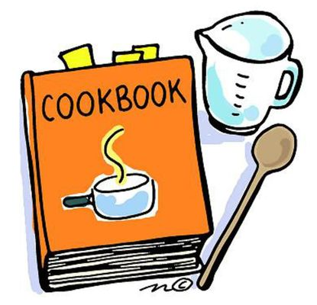
DNA
Adenine (A)
Thymine (T)
Cytosine (C)
Guanine (G)

Slide 4
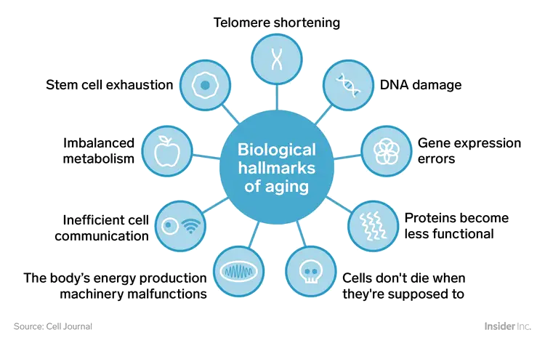
Hallmarks of aging
Notes:
https://www.businessinsider.com/biology-of-aging-why-bodies-get-old-2018-8?r=US&IR=T#errors-appear-in-dna-1

Slide 5
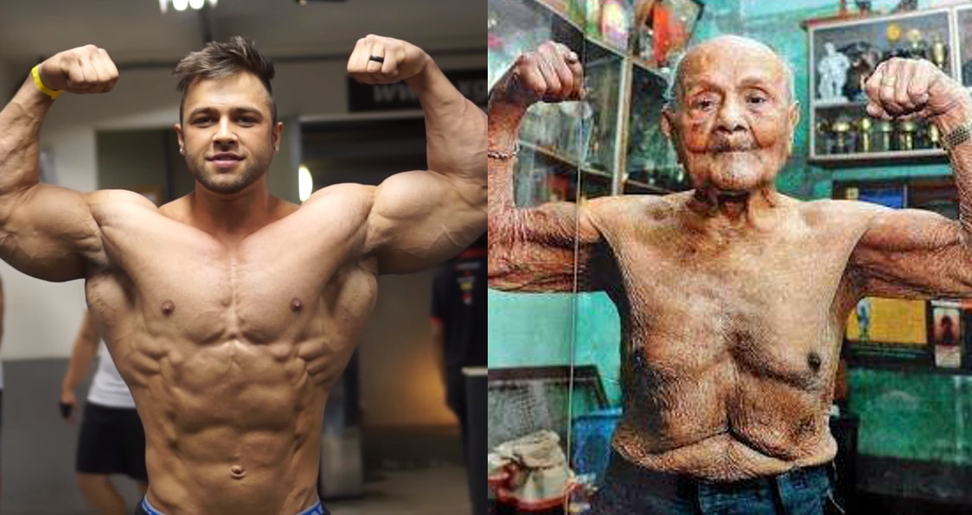

Slide 6


Slide 7
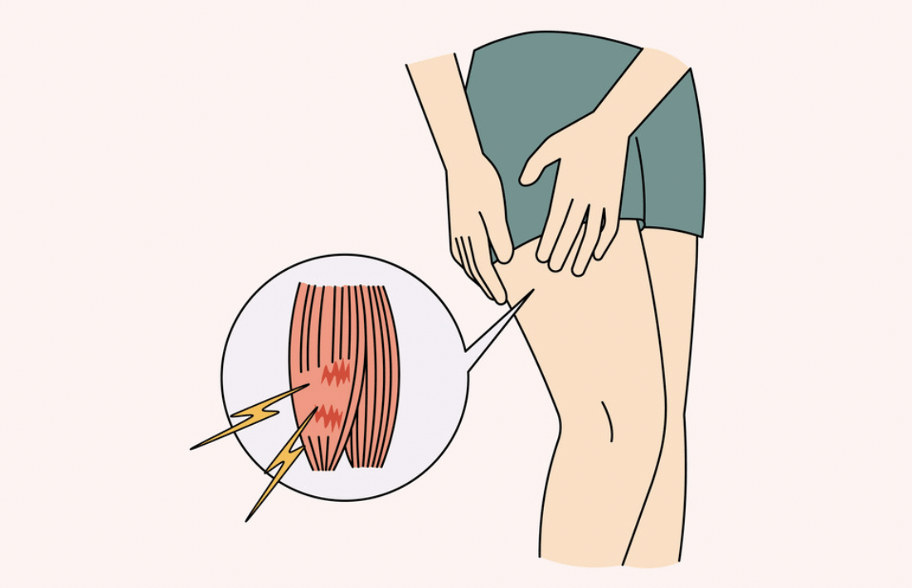
delayed onset muscle soreness (DOMS)
7

Slide 8
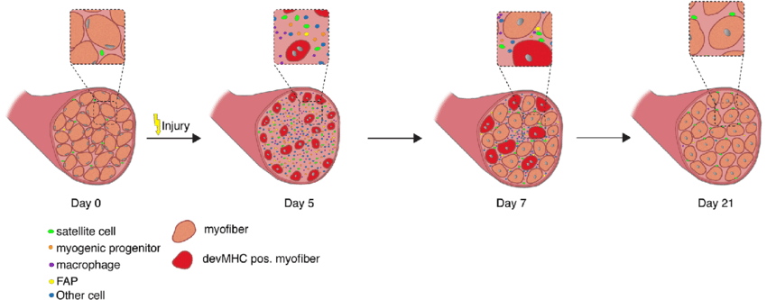
Regeneration of skeletal muscle
Notes:
https://www.researchgate.net/figure/Regeneration-of-skeletal-muscle-Time-course-of-changes-in-cellular-composition-during_fig2_332352650

Slide 9
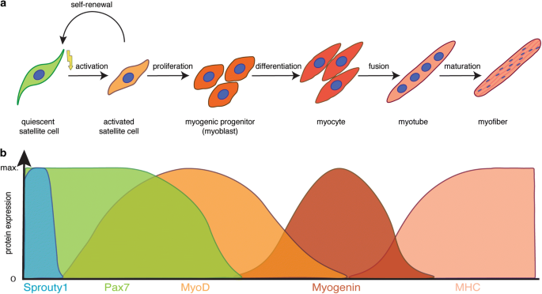

Slide 10
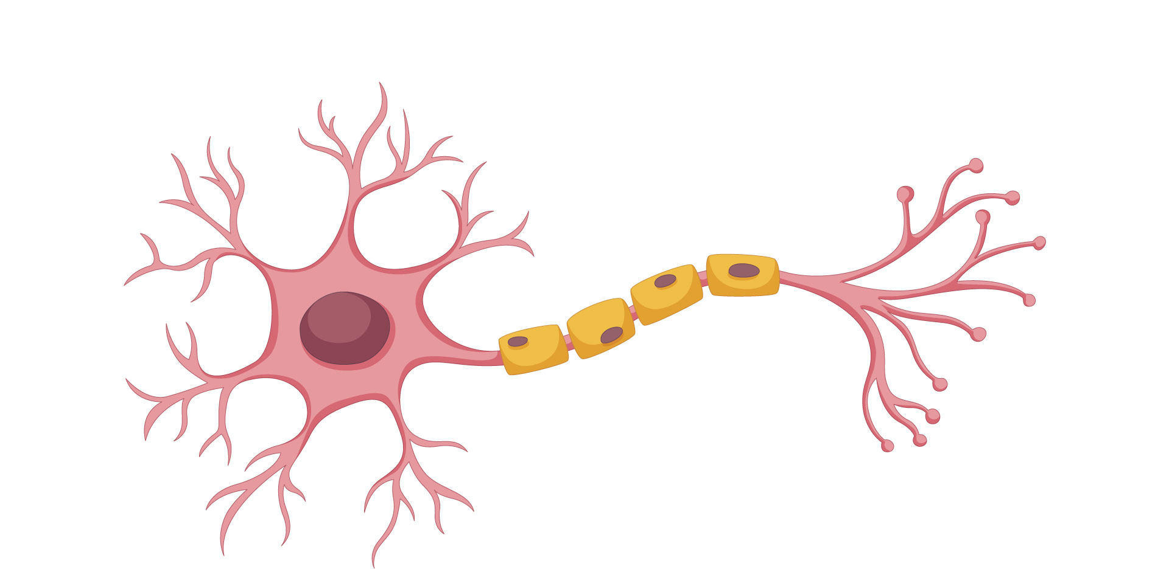
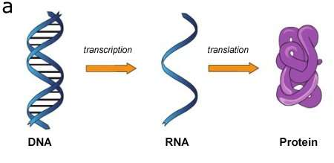


Slide 11


TRANSCIPTION REGULATION

Slide 12
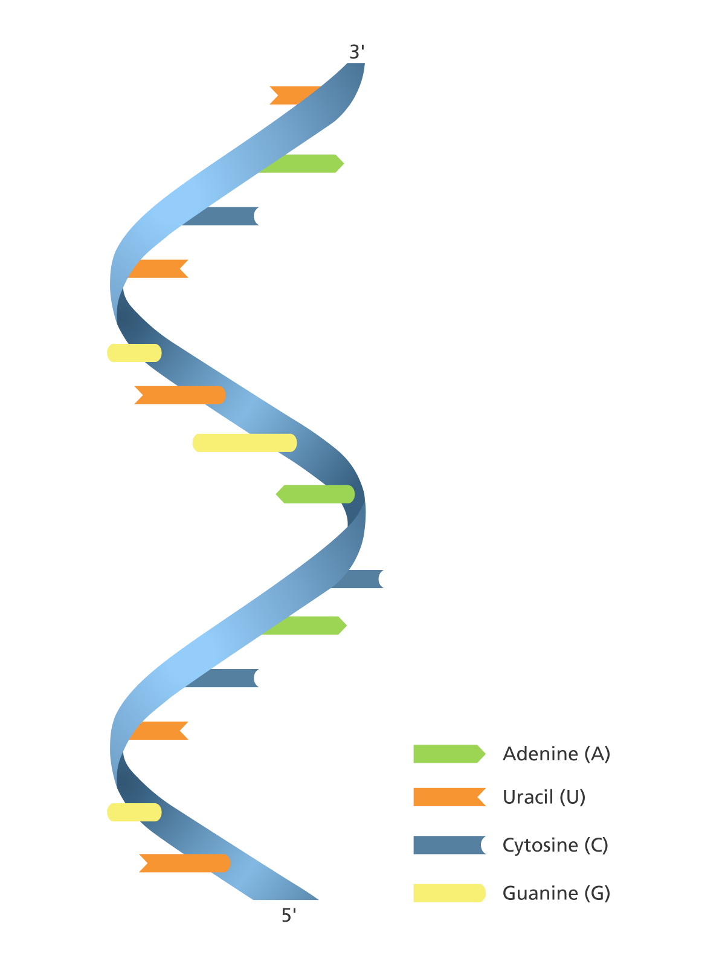

Micro RNA
SMALL
8 – 30 nucleotides long
Regulate multiple processes at the same time
Non toxic
Tend to work in groups
In comparison
DNA
Hundreds of Millions
RNA
Thousands

Slide 13
Micro RNA
SMALL
8 – 30 nucleotides long
Regulate multiple processes at the same time
Non toxic
Tend to work in groups
In comparison
DNA
Hundreds of Millions
RNA
Thousands

Slide 14
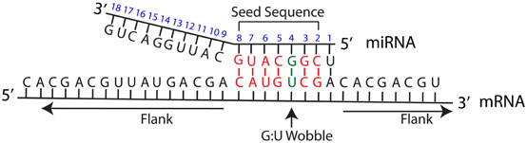
microRNAs BLOCK mRNAs BY BINDING IT

Slide 15
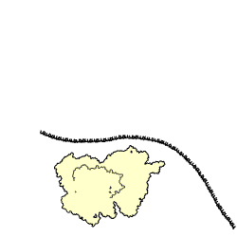
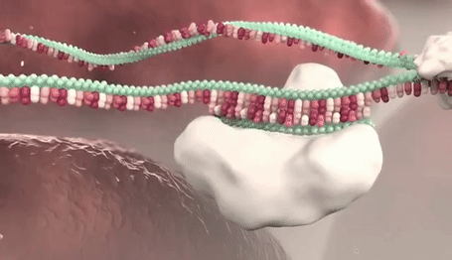

Slide 16

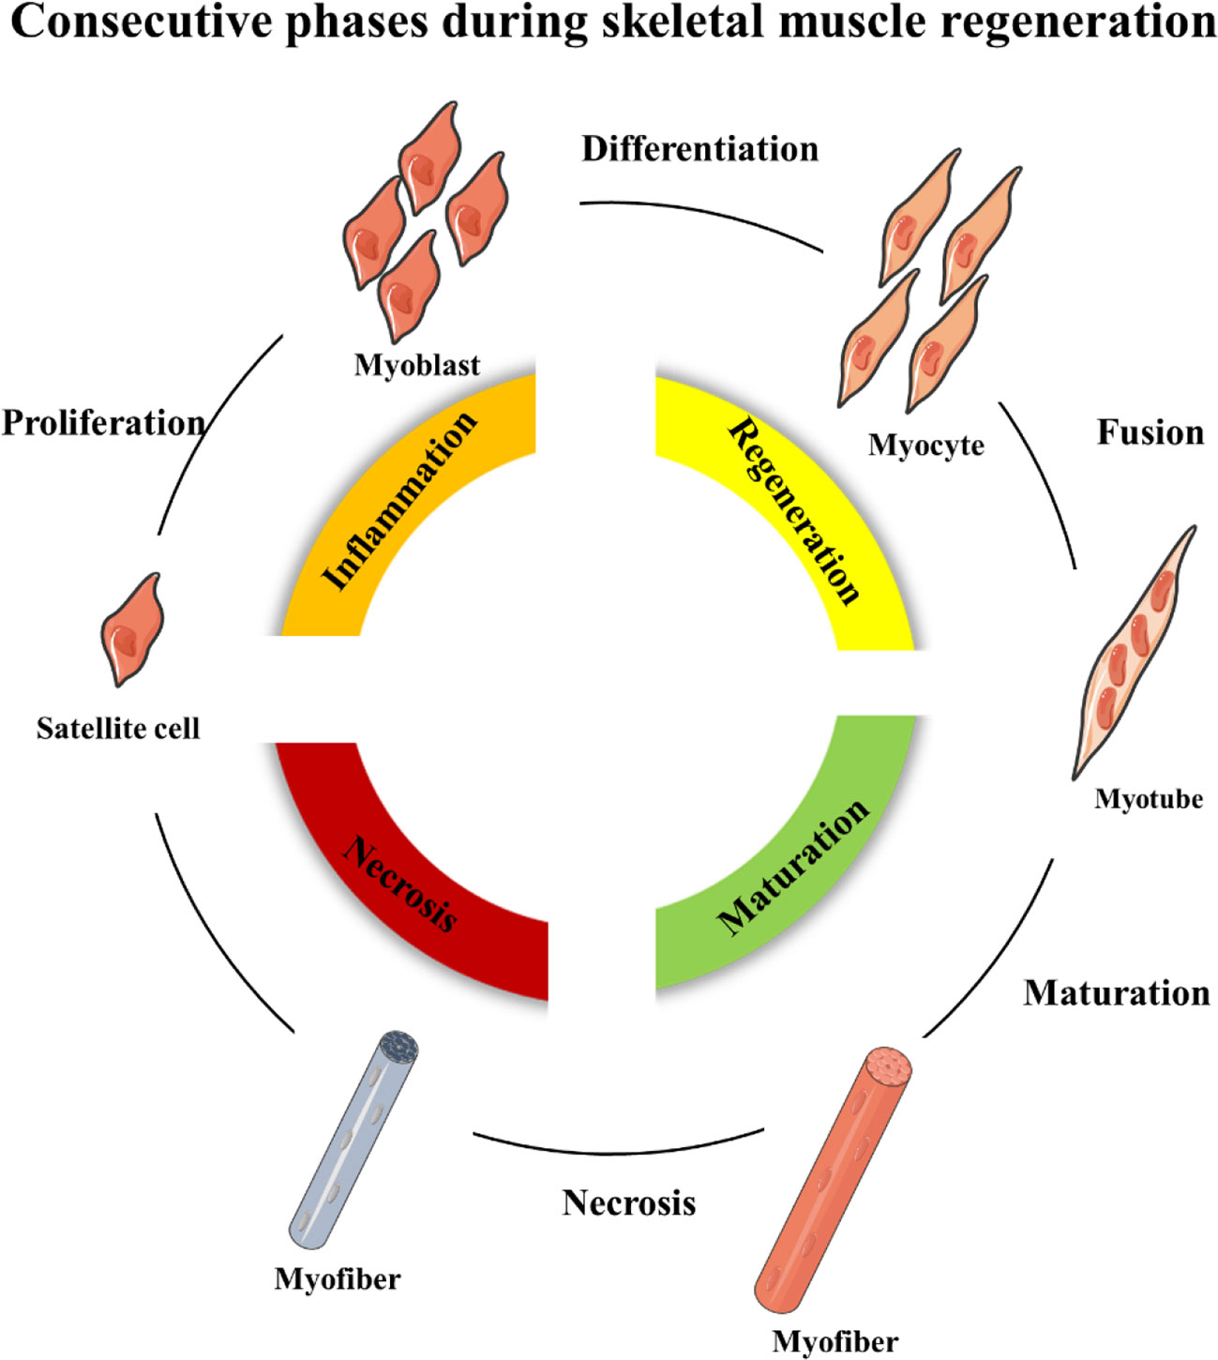
muscle development, function and regulation miRNAs
miR-1
miR-133
miR-206

Slide 17
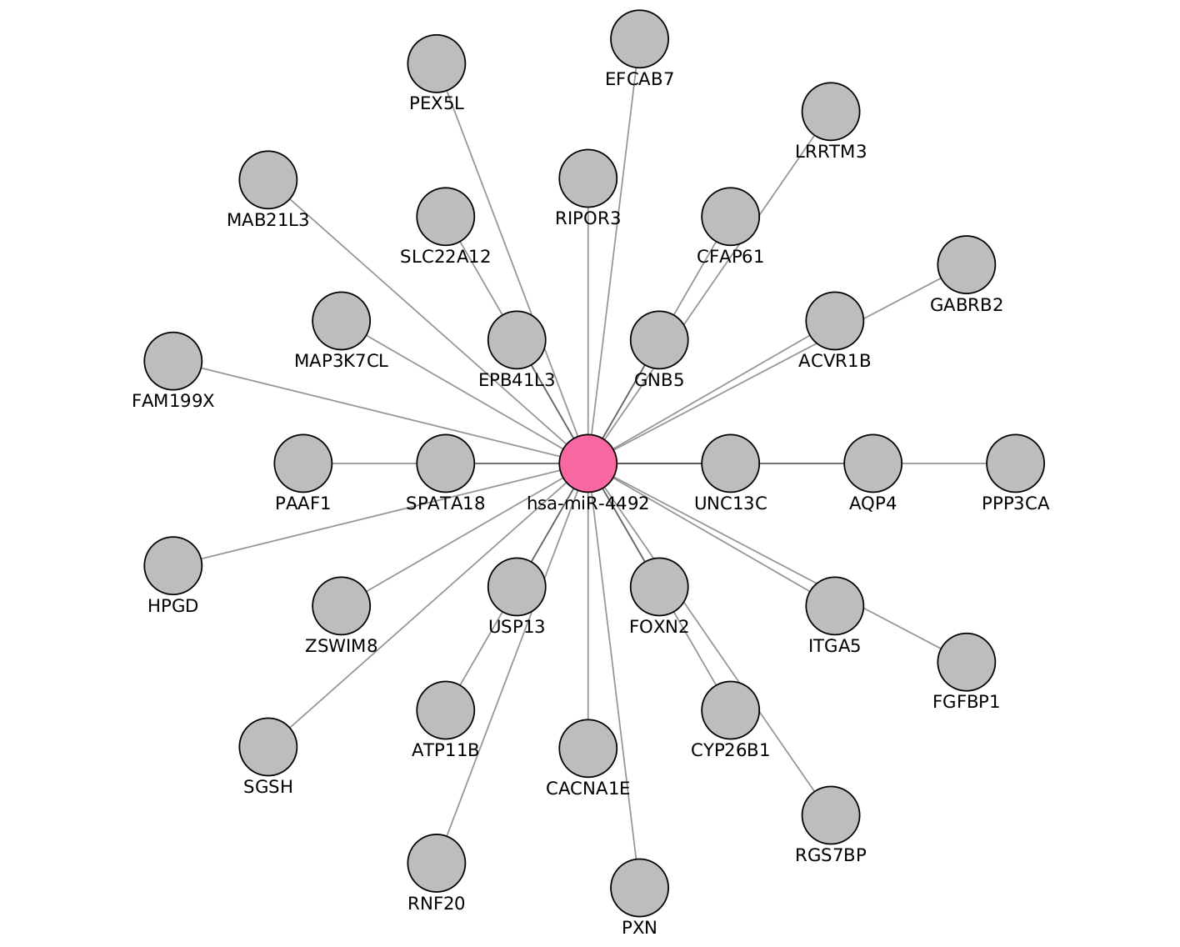
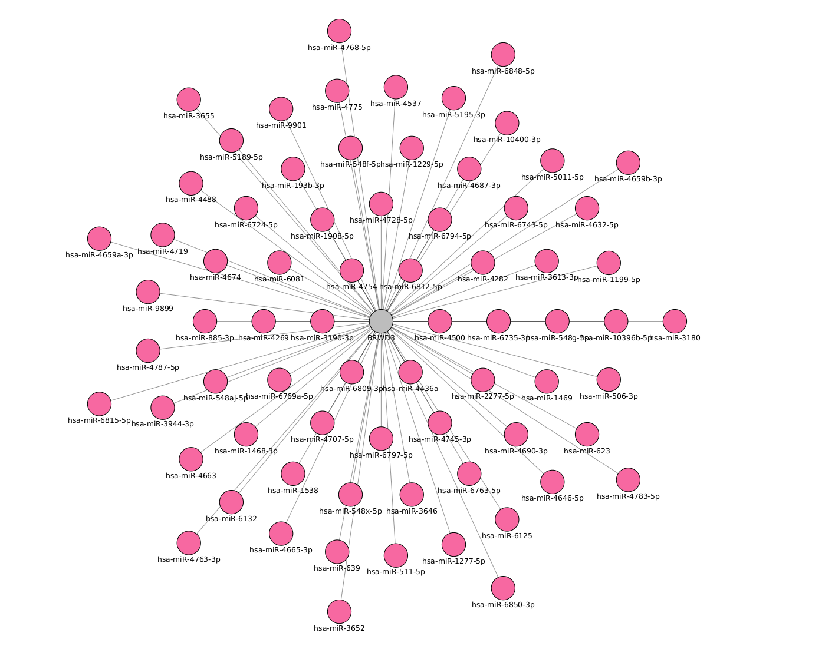
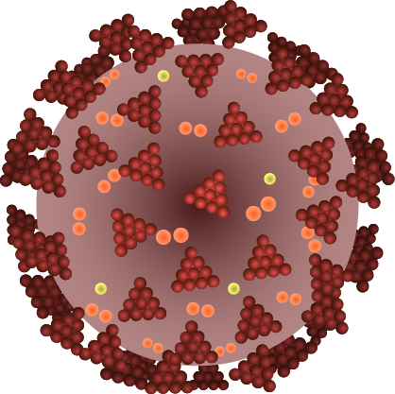
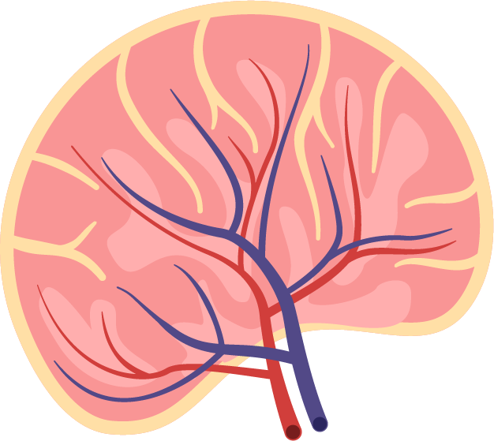
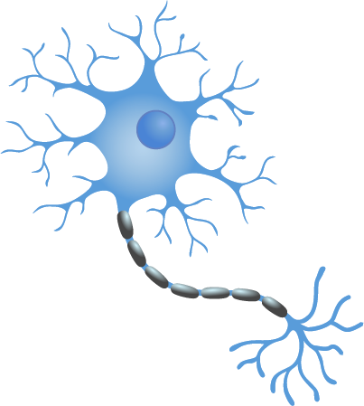

Slide 18
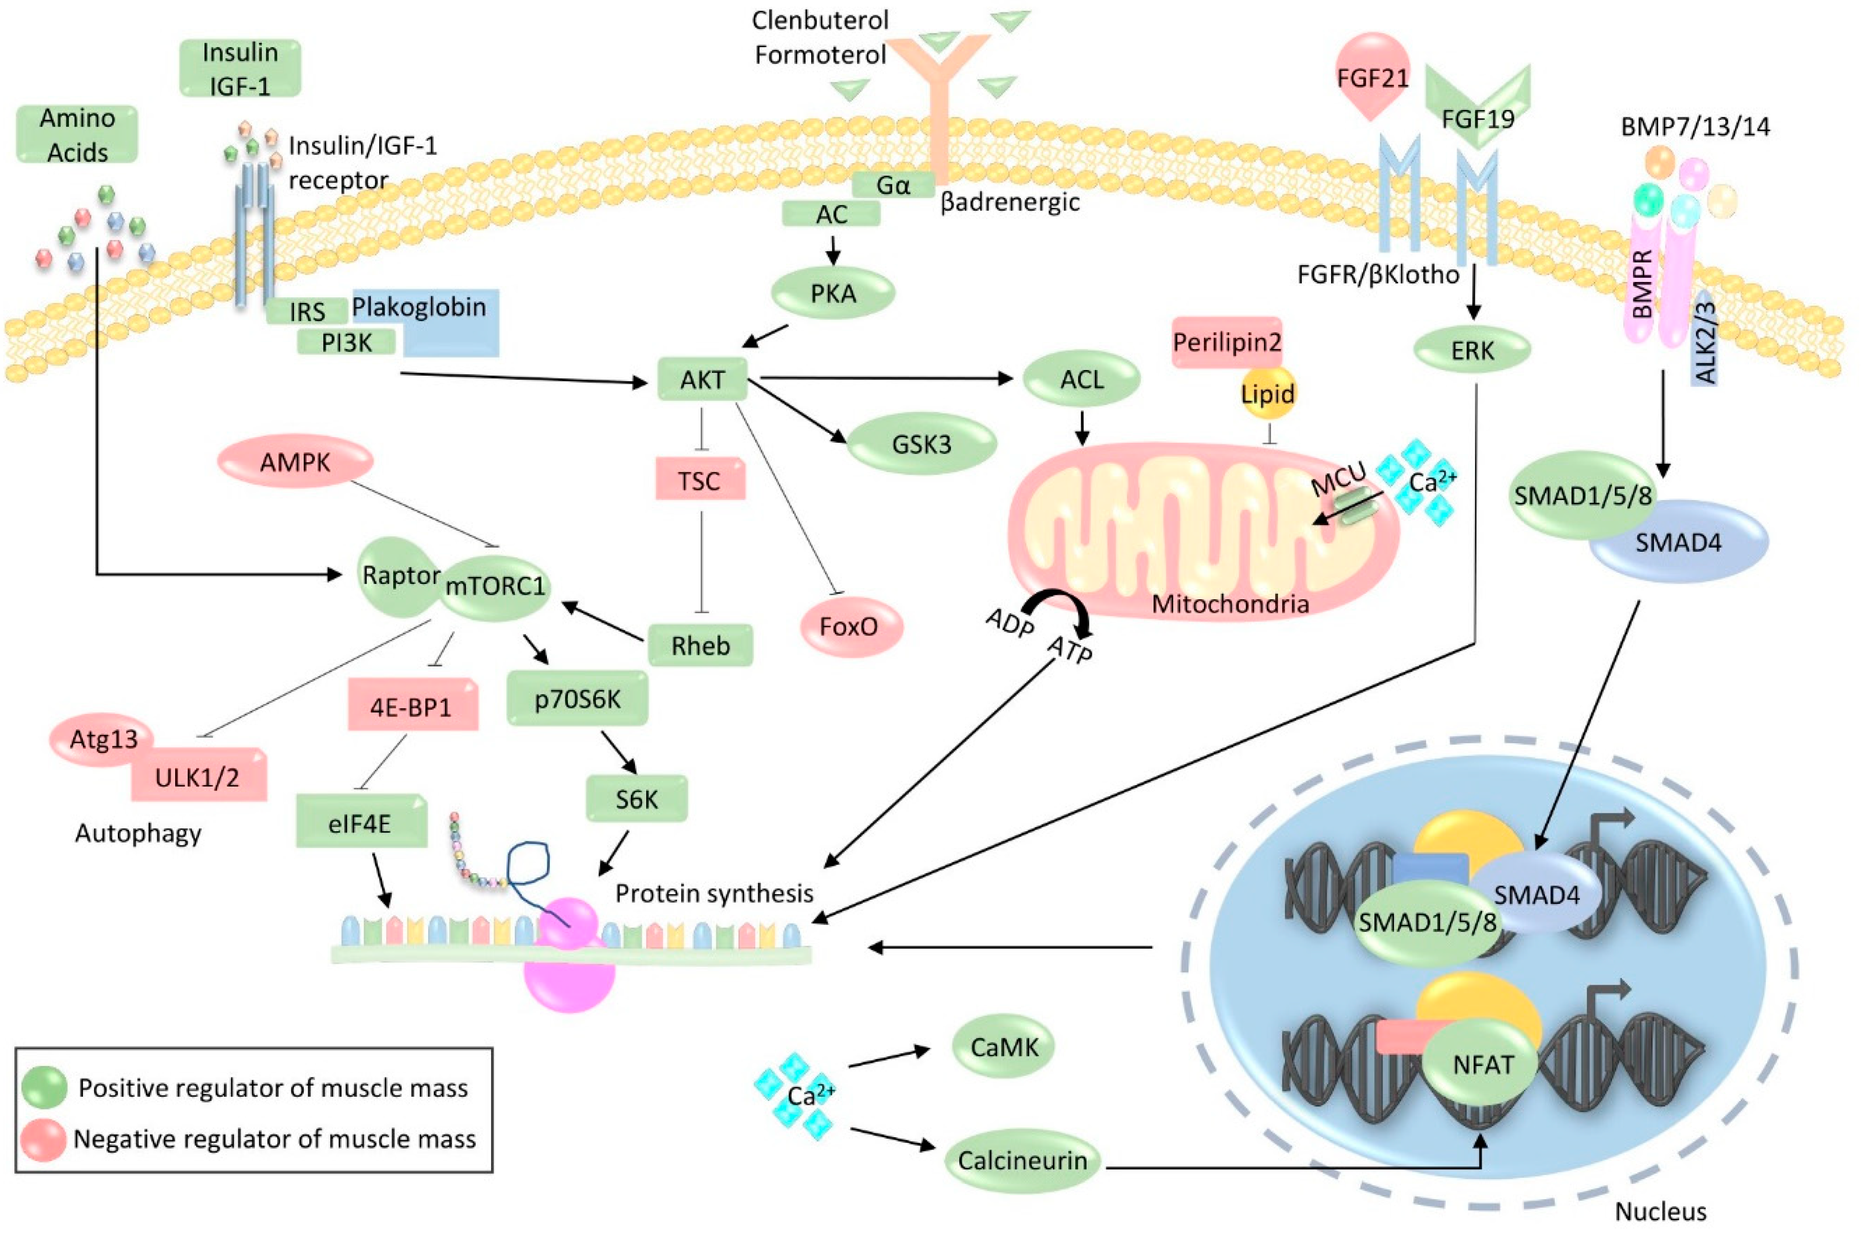

Slide 19
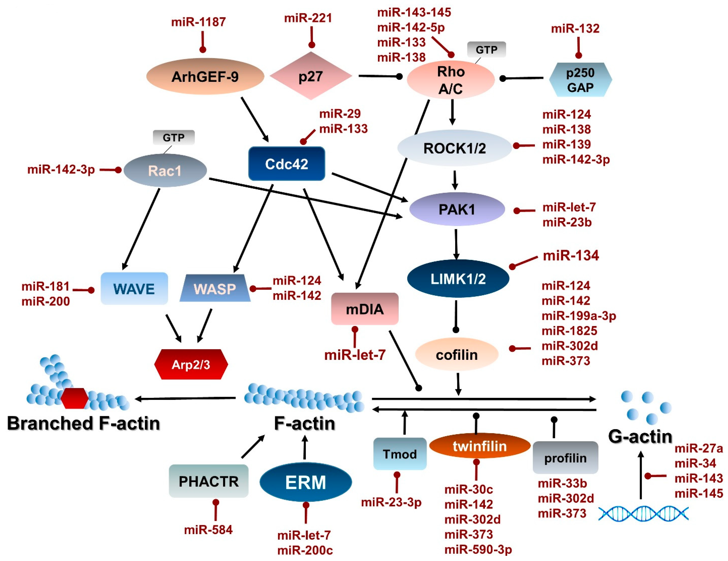

Slide 20
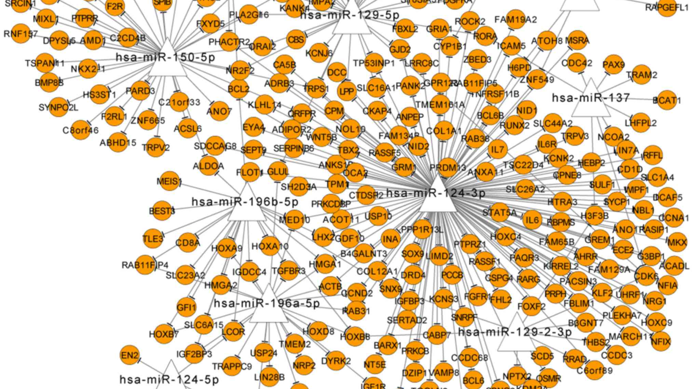

Slide 21
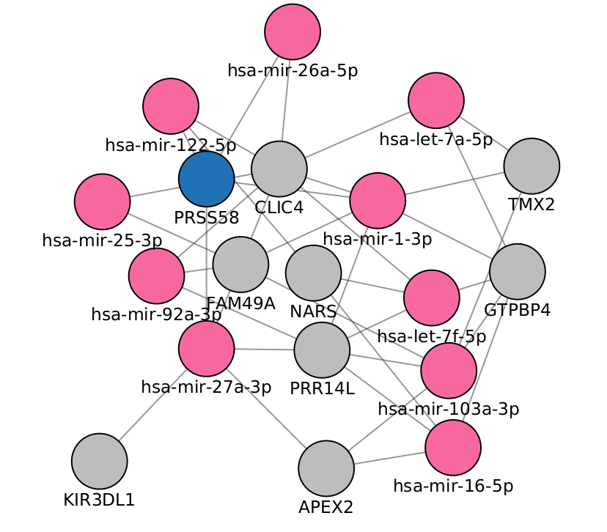

Computational models to understand

Slide 22
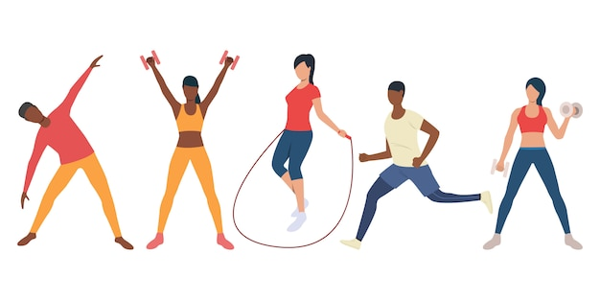
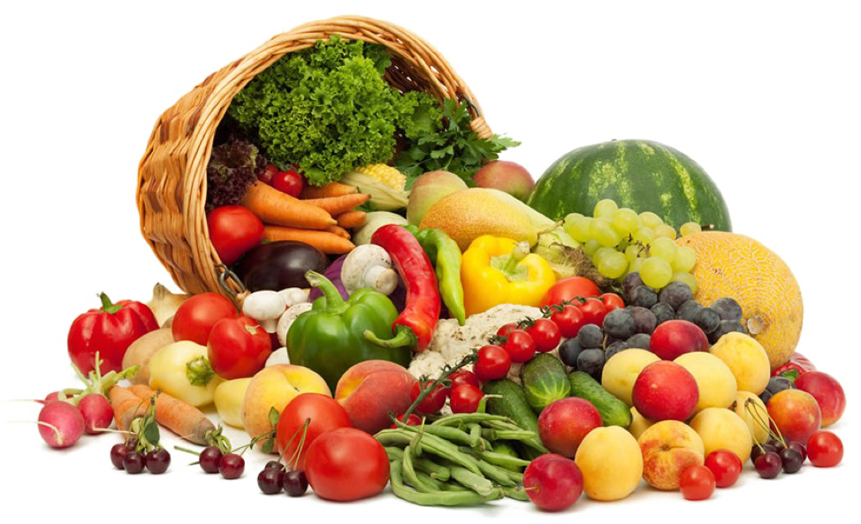
In the mean time

Slide 23
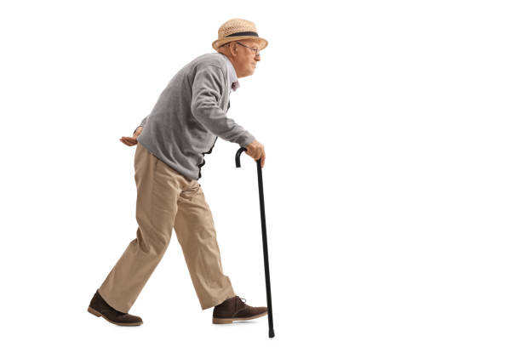
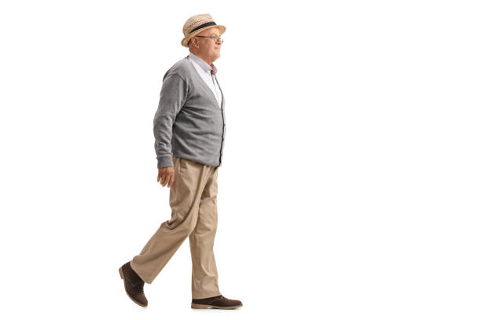

Slide 24
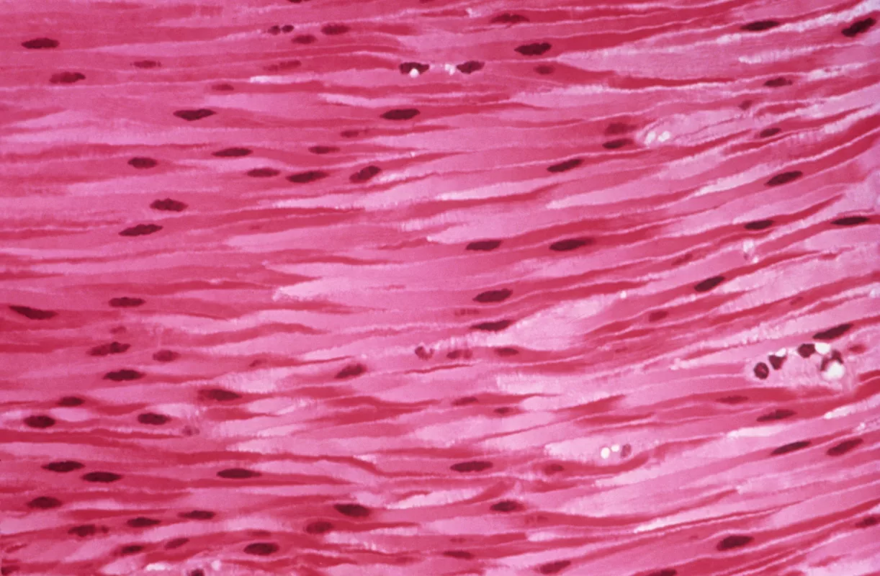
THANK
Karen Guerrero Vazquez
K.GuerreroVazquez1@nuigalway.ie
You

